Slide 1
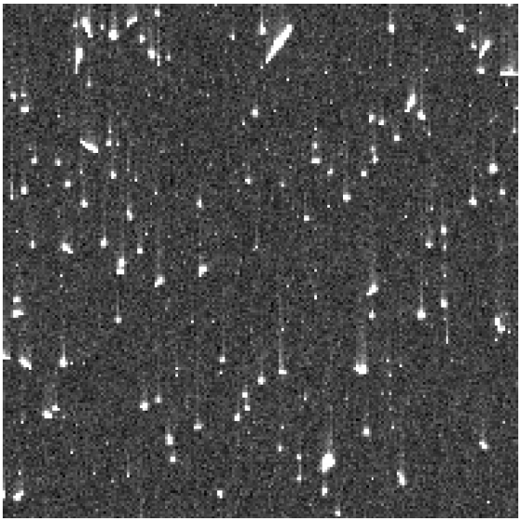
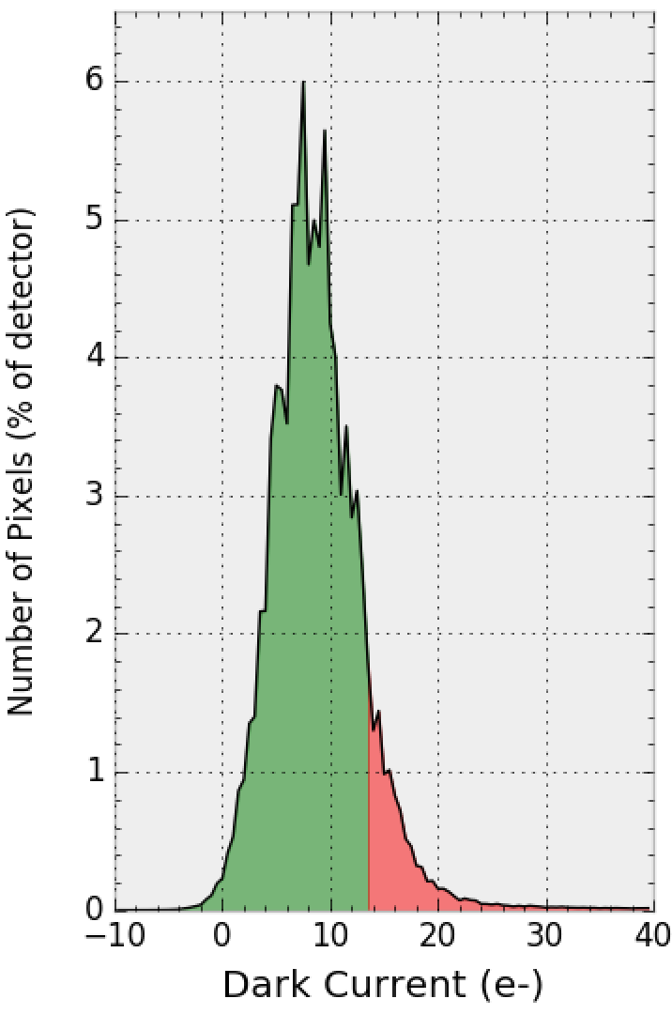
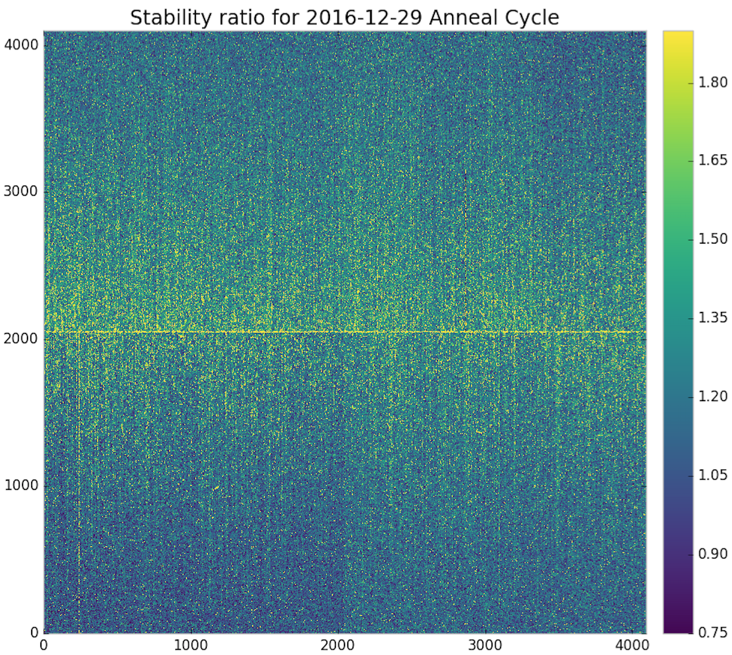
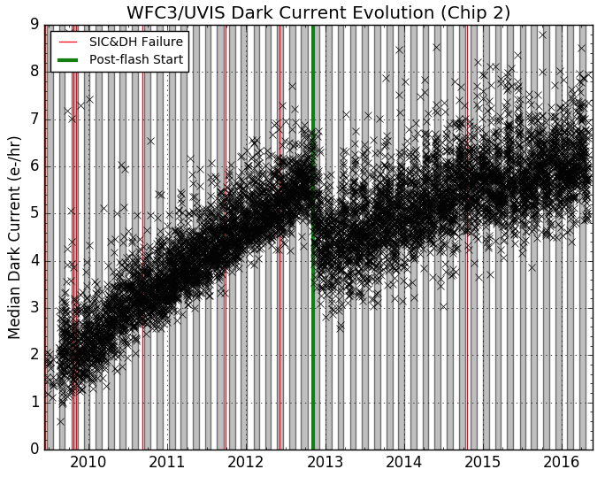
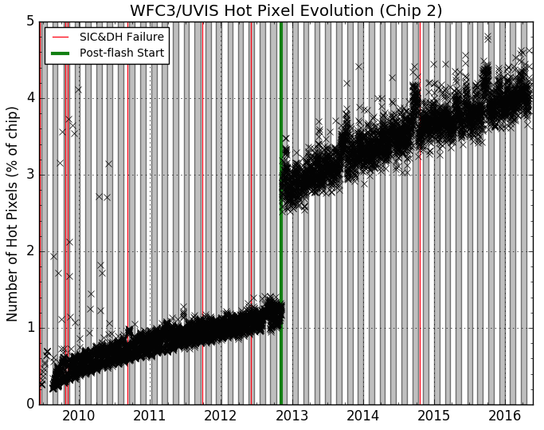
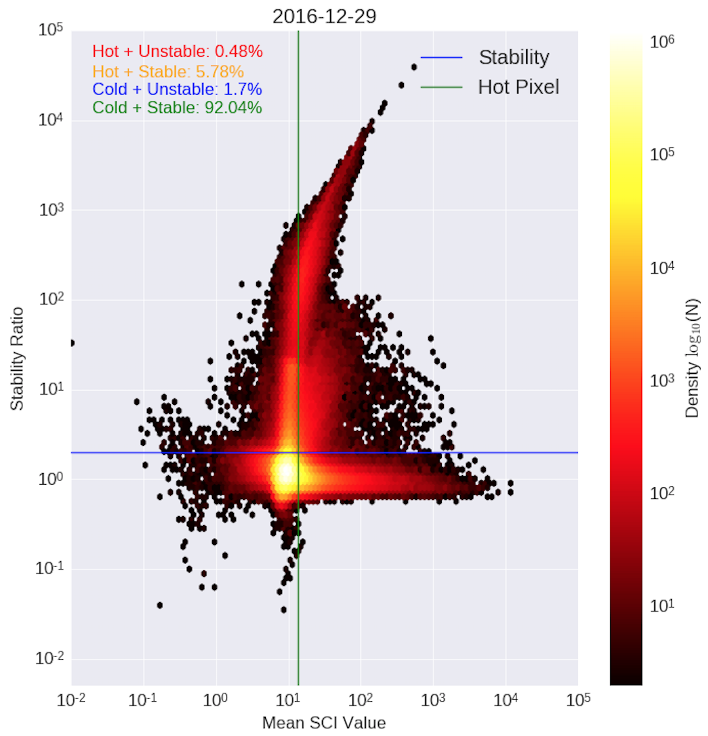
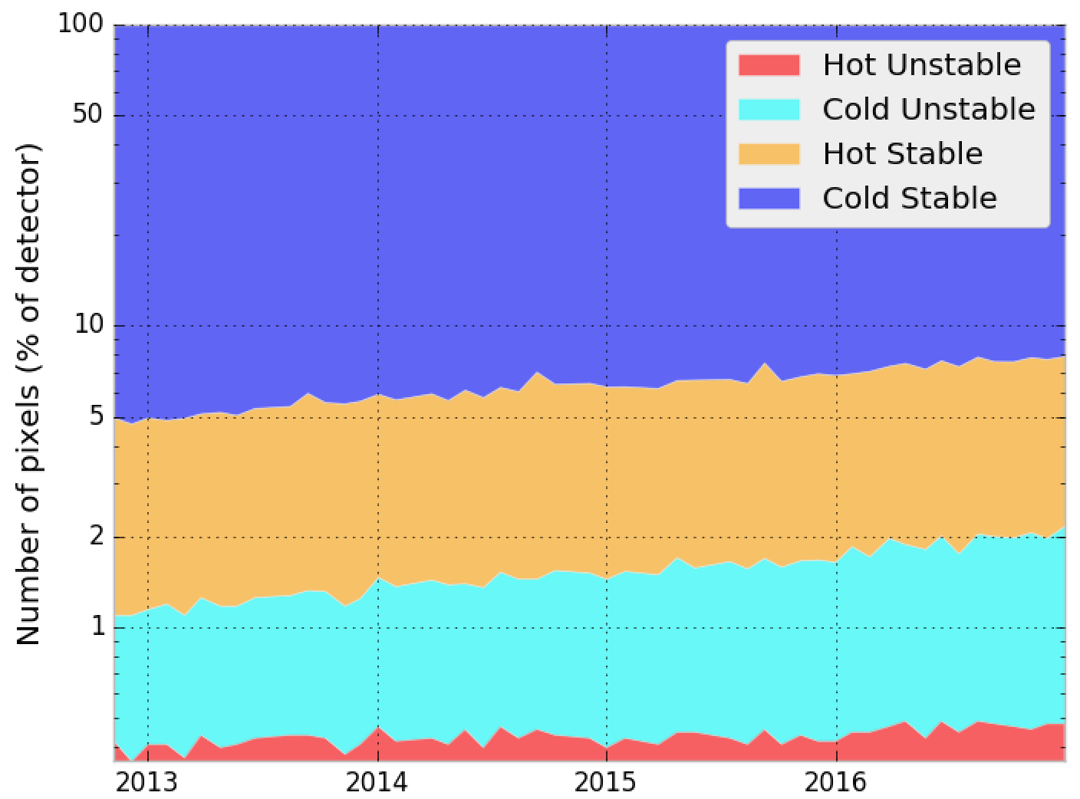
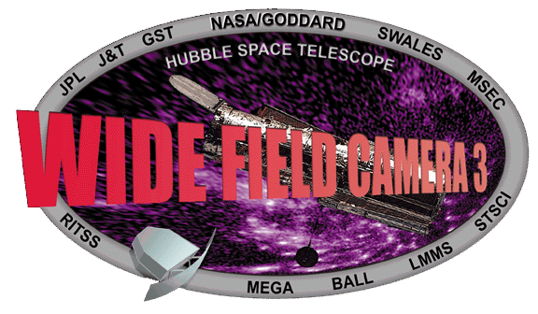


Using Dark Images to Characterize the Stability of Pixels in the WFC3/UVIS Detector
Matthew Bourque, Sylvia Baggett, David Borncamp, Norman Grogin, and the WFC3 Team (STScI)
Abstract
The Ultraviolet-Visible (UVIS) detector on board the Hubble Space Telescope's (HST) Wide Field Camera 3 (WFC3) instrument has been acquiring 'dark' images on a daily basis since its installation in 2009. These dark images are 900 second exposures with the shutter closed as to measure the inherent dark current of the detector. Using these dark exposures, we have constructed ‘pixel history' images in which a specific column of the detector is extracted from each dark and placed into a new time-ordered array. We discuss how the pixel history images are used to characterize the stability of each pixel over time, as well as current trends in the WFC3/UVIS dark current.
UVIS Dark Observations
Pixel Stability
(Left) A 50x50 pixel region taken from a 900-second UVIS dark, showing the nominal features of background dark current, cosmic rays, and hot pixels (defined as pixels with dark current exceeding 54 e-/hr).
(Right) The distribution of pixel values in a 900-second UVIS dark. The pixels with values exceeding the 54 e-/hr threshold (13.5 e- in 900 sec) are shaded in red. Bin size is 0.5 e-.
Hot Pixels and Dark Current
The median dark current (left) and number of hot pixels (right) over time for Chip 2 (Amps C & D). Dark current increases roughly 0.5 e-/hr/year and is currently ~8 e-/hr. Approximately 1000 new hot pixels above the 54 e-/hr threshold appear every day, currently occupying ~4% of each chip. Each month, the UVIS detector is warmed to +20C (shaded in gray/white regions), erasing 10-20% of the hot pixels.
‘Pixel History’ Images
References
Poster 117.11
Dave’s ISR
STScI Help Desk: help@stsci.edu

